Slide 1
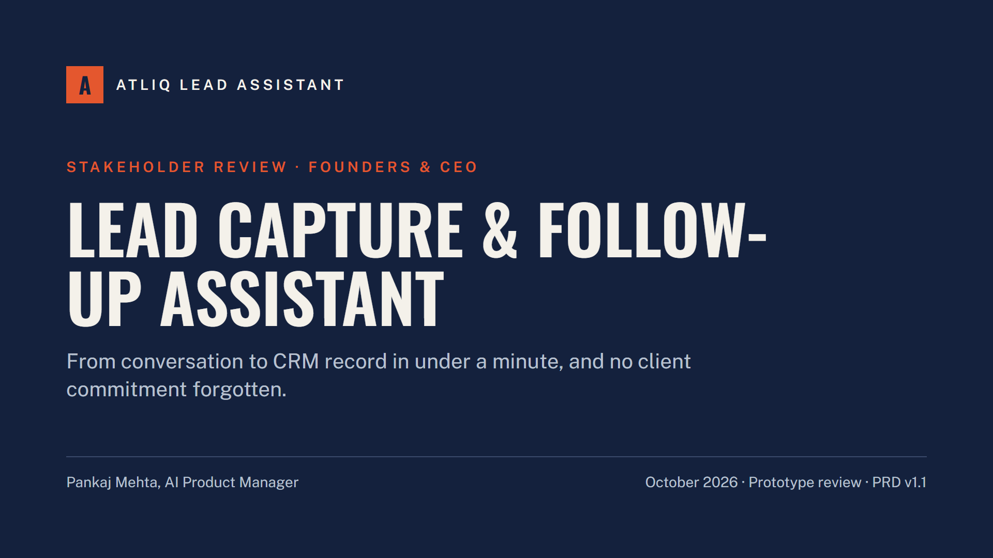
Notes:
Purpose of this session: show what the working prototype does, how it stays safe, what it costs, and agree the four decisions we need to move to the shadow test in December.

Slide 2
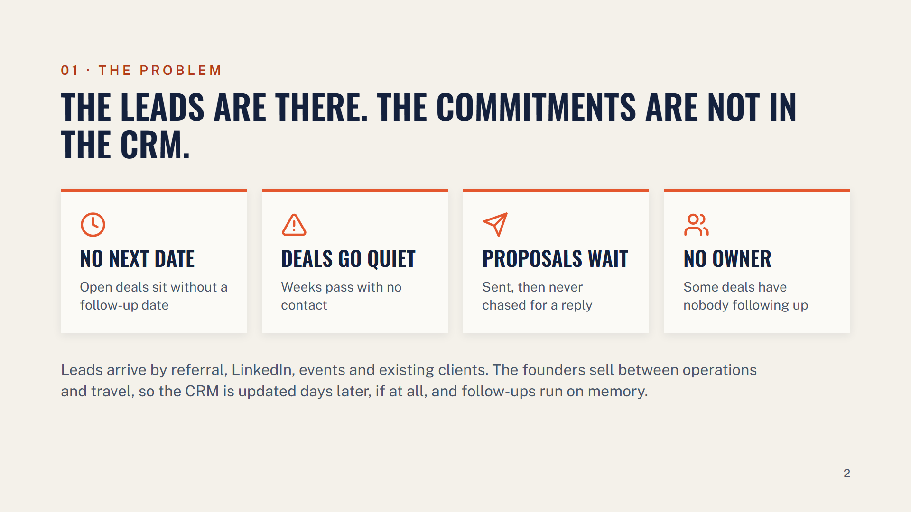
Notes:
The lead flow is healthy. What we lose is the follow-through: promises made in meetings and emails never reach the CRM, so deals go quiet without anyone noticing.

Slide 3
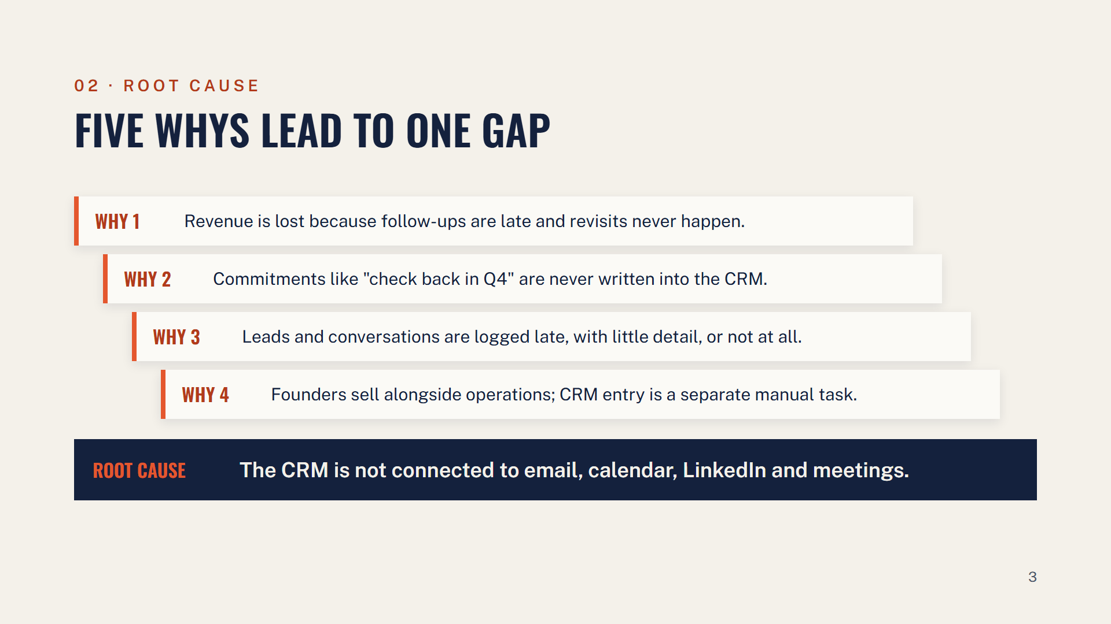
Notes:
Click to reveal each why, then the root cause. This is why a better CRM screen alone would not fix it: the fix has to start where the conversation happens and remove the typing step, while keeping the owner in control of what is saved.

Slide 4
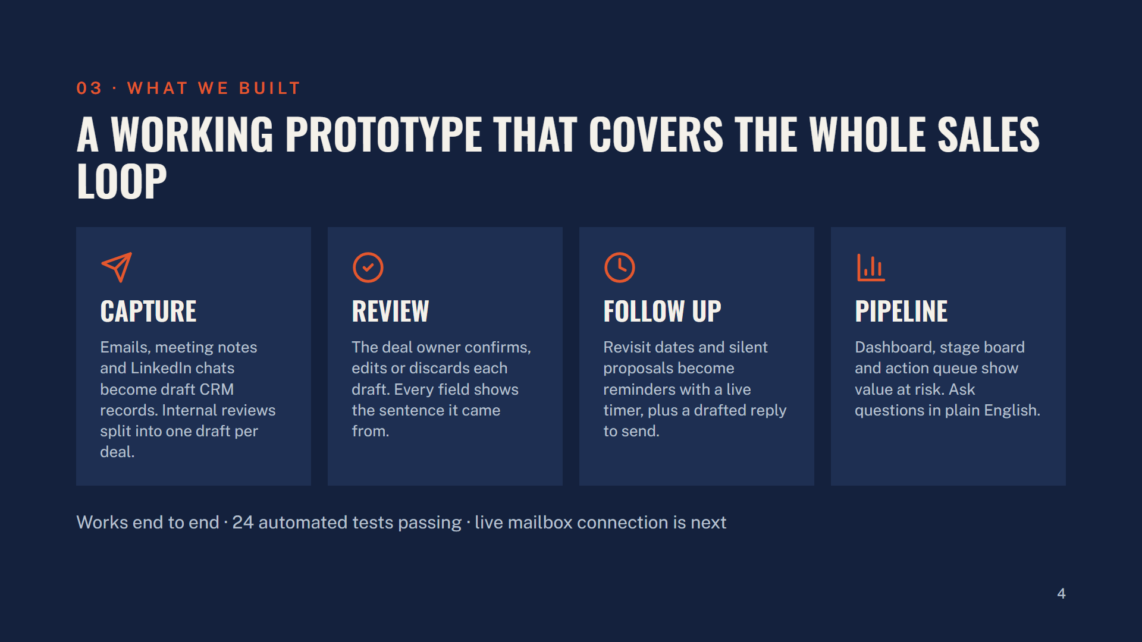
Notes:
The prototype runs end to end. What is not built yet is the live connection to our mailboxes and calendars; today conversations are pasted, uploaded or synced from a test mailbox.

Slide 5
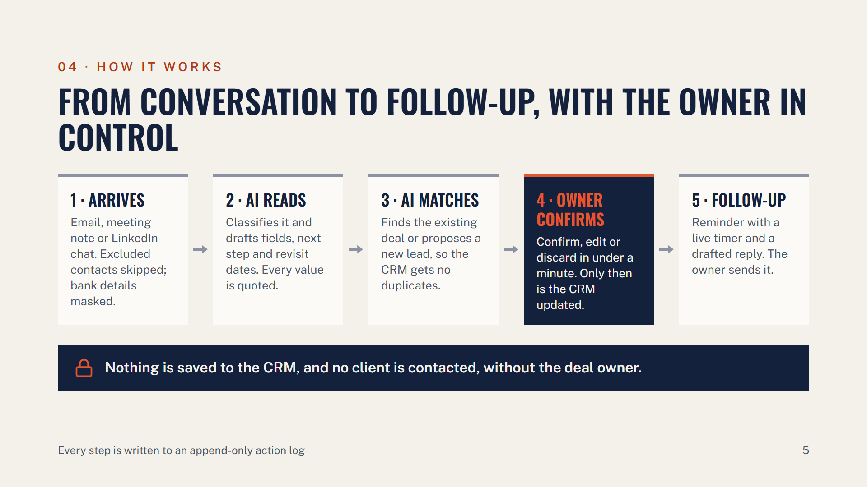
Notes:
Steps 1 to 3 are automatic. Step 4 is the owner's decision and is the only path into the CRM. Step 5 reminds the owner; the assistant has no ability to send email.

Slide 6
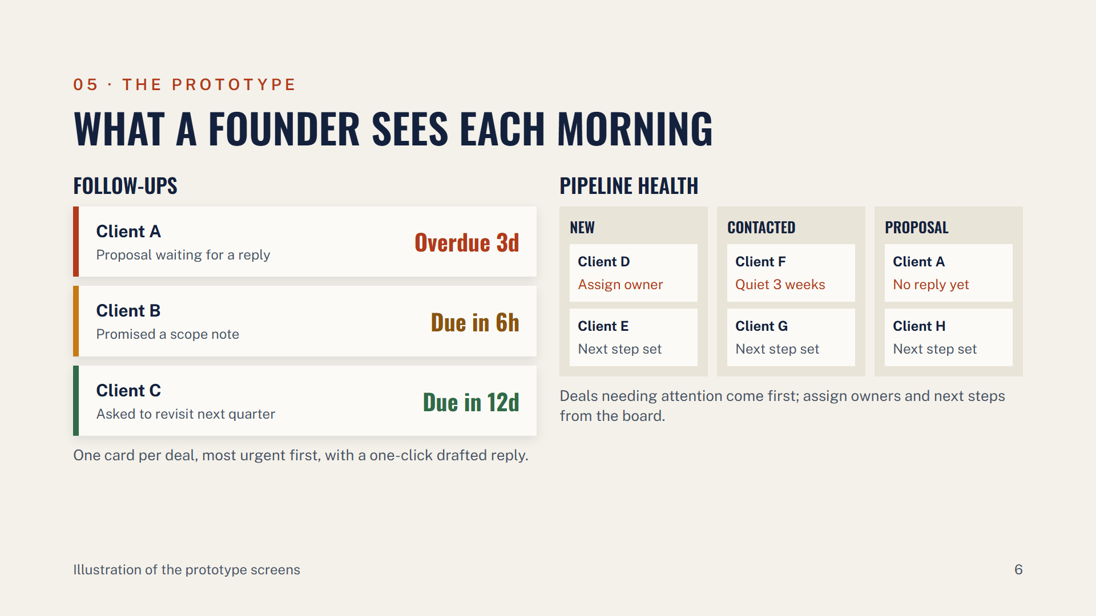
Notes:
Left: the follow-up queue, one card per deal with a live timer that turns red when overdue. Right: the pipeline board by stage, with deals that need attention at the top and owner and next-step fixes right on the card.

Slide 7
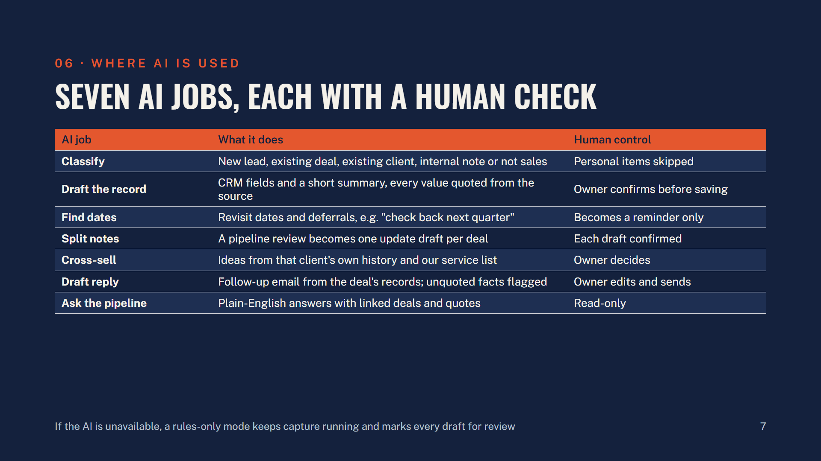
Notes:
Three of these run automatically on every conversation: classify, draft the record and find dates. Draft reply and ask the pipeline run only when someone clicks. None of them can write to the CRM or contact a client.

Slide 8
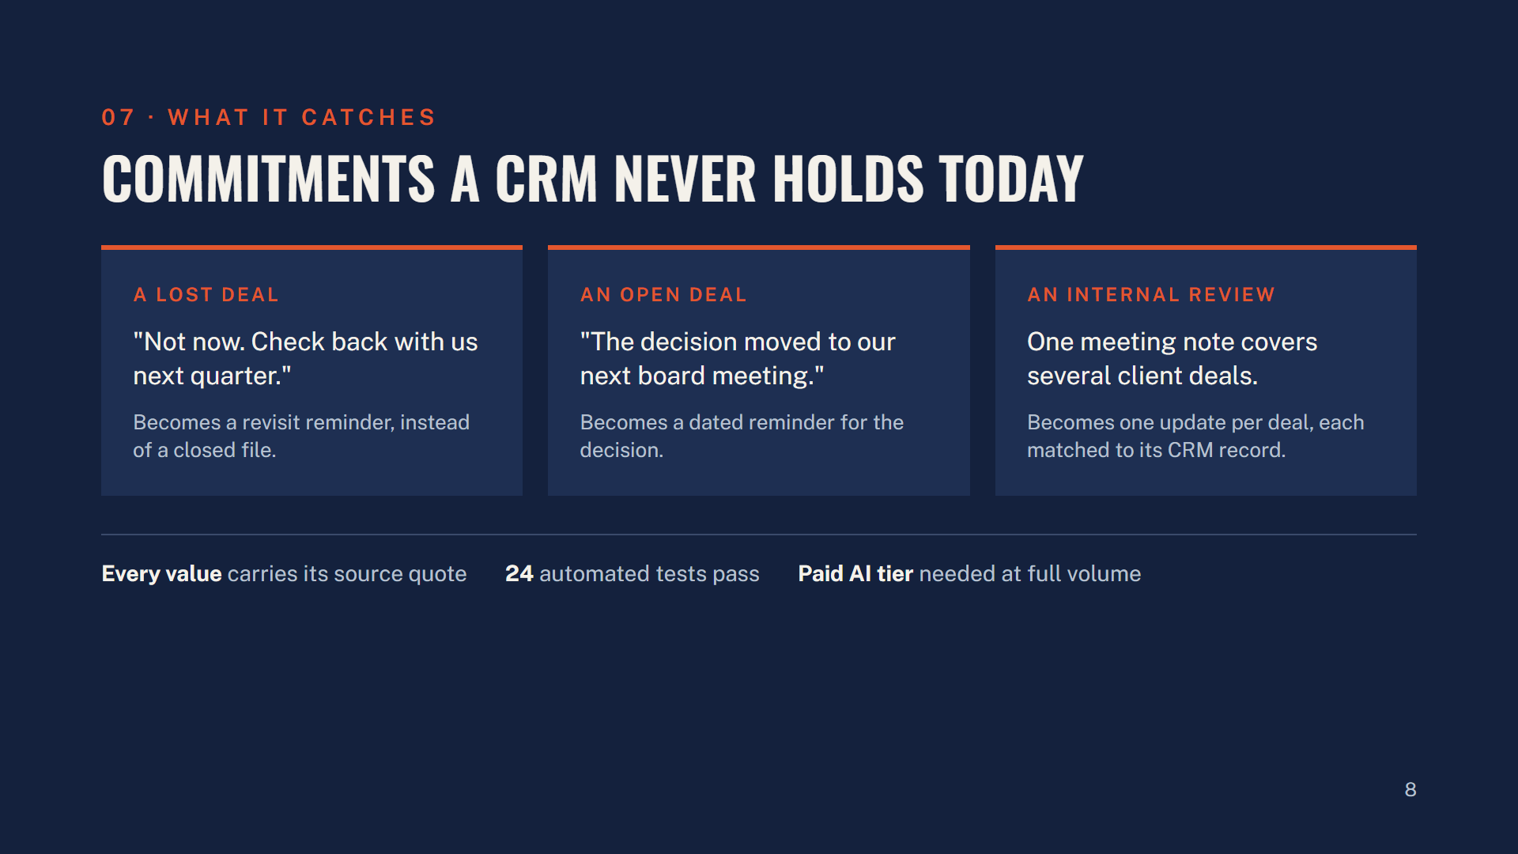
Notes:
These are the "check back later" signals that get lost today. A lost deal with a revisit date is a future deal; the assistant keeps that date. A decision date mentioned once in an email becomes a reminder. An internal review that discusses several deals becomes one update per deal.

Slide 9
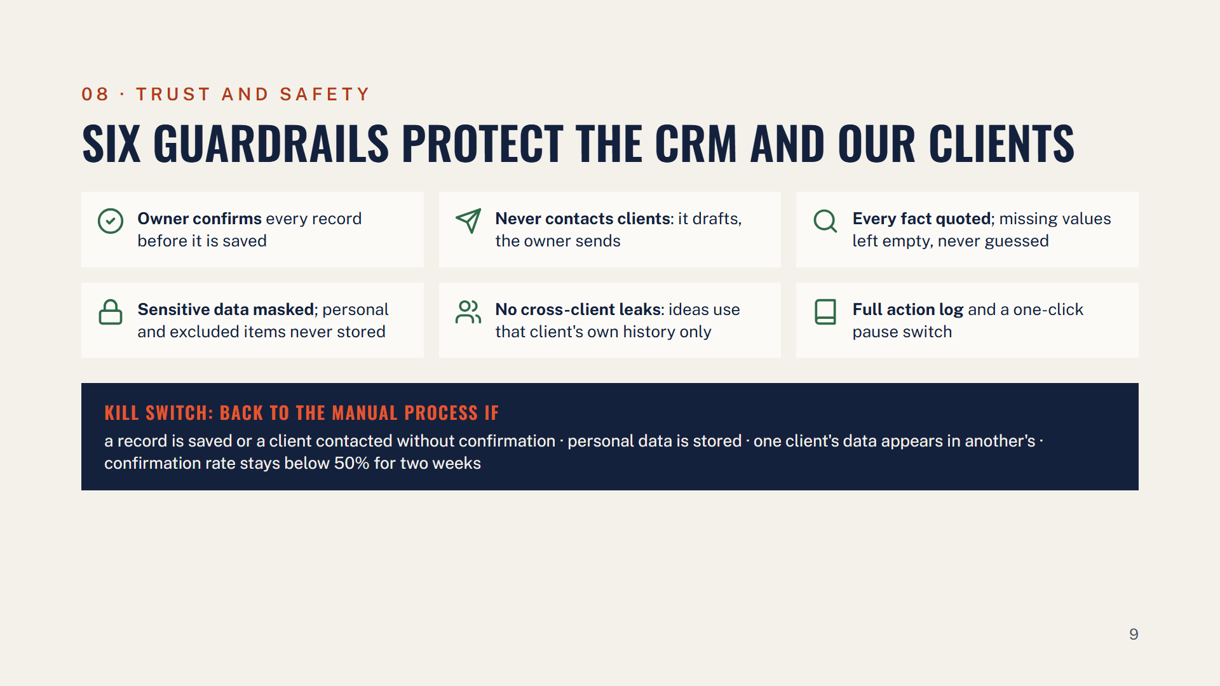
Notes:
The single most important rule: the CRM only changes when the deal owner clicks confirm, and the assistant has no ability to send anything to a client. Everything else supports that.

Slide 10
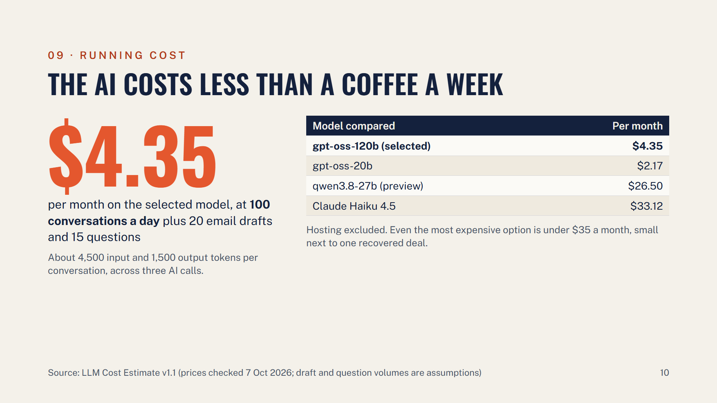
Notes:
We use gpt-oss-120b. The real constraint is not price but the provider's daily usage limit: the free tier runs out at full volume, so we need the paid tier, roughly 600 thousand tokens a day.

Slide 11
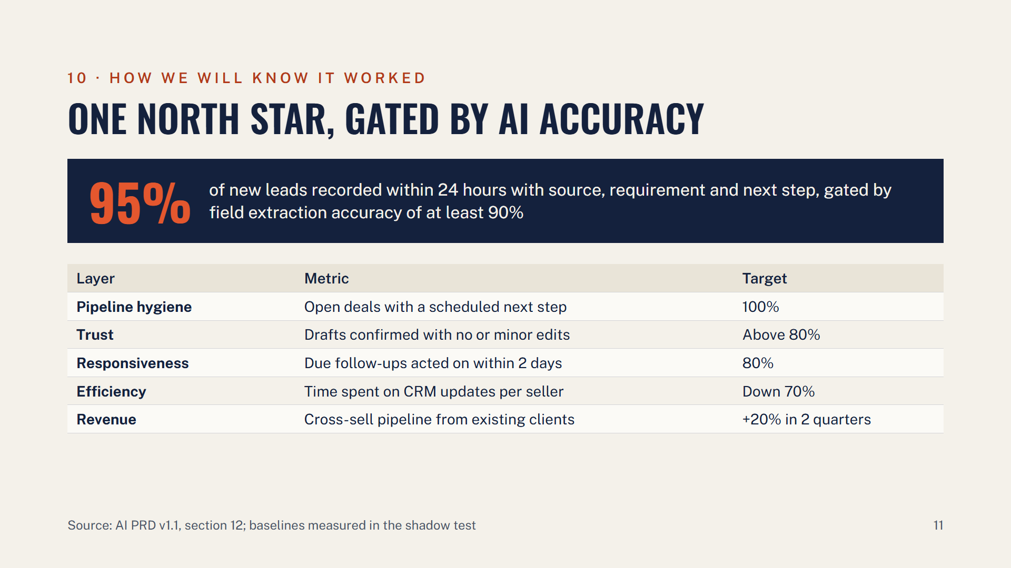
Notes:
The North Star comes straight from the pain point: leads recorded fast and complete. It only counts if the AI's field accuracy is at least 90 percent on our labelled test set, so we cannot hit it by accepting bad drafts.

Slide 12
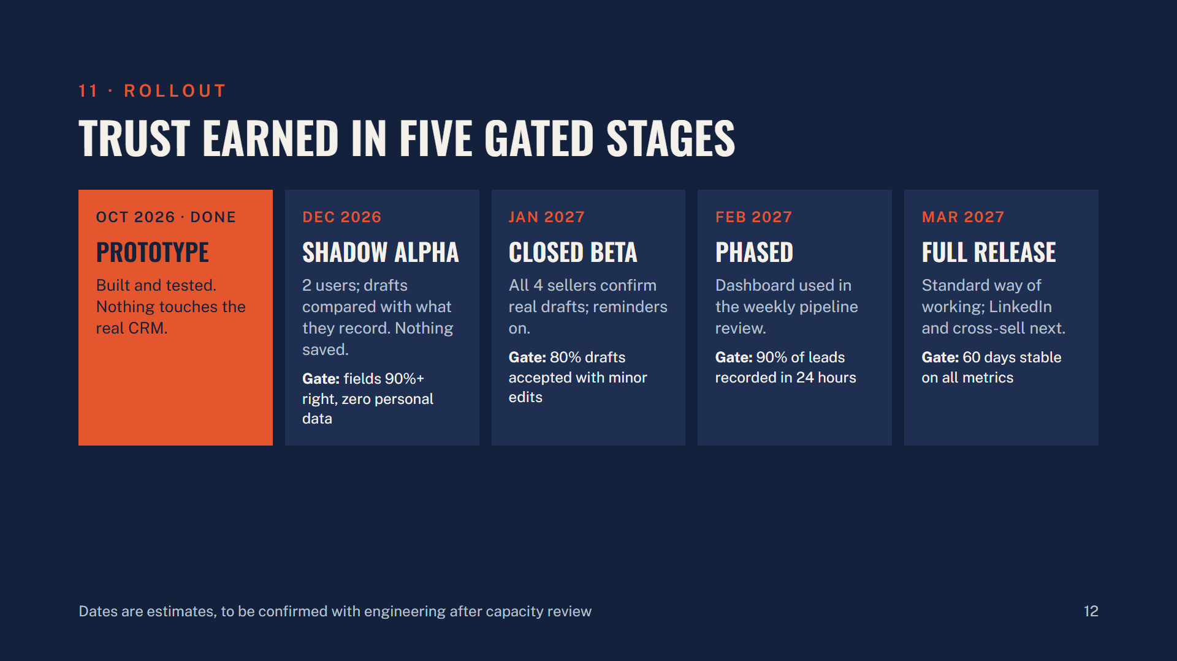
Notes:
Each stage has a gate we must meet before moving on, and the kill-switch rules apply at every stage. The shadow test in December is the first time the assistant reads real email, which is why consent is the first decision on the next slide.

Slide 13
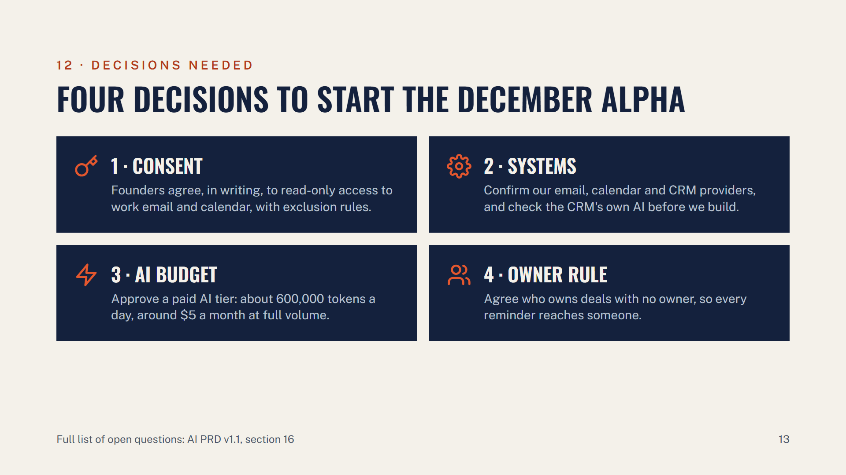
Notes:
Smaller open items for later: whether pipeline stages stay as the CRM's three or add Qualified and Negotiation, and how reminders reach owners outside the app, by email digest or push.

Slide 14
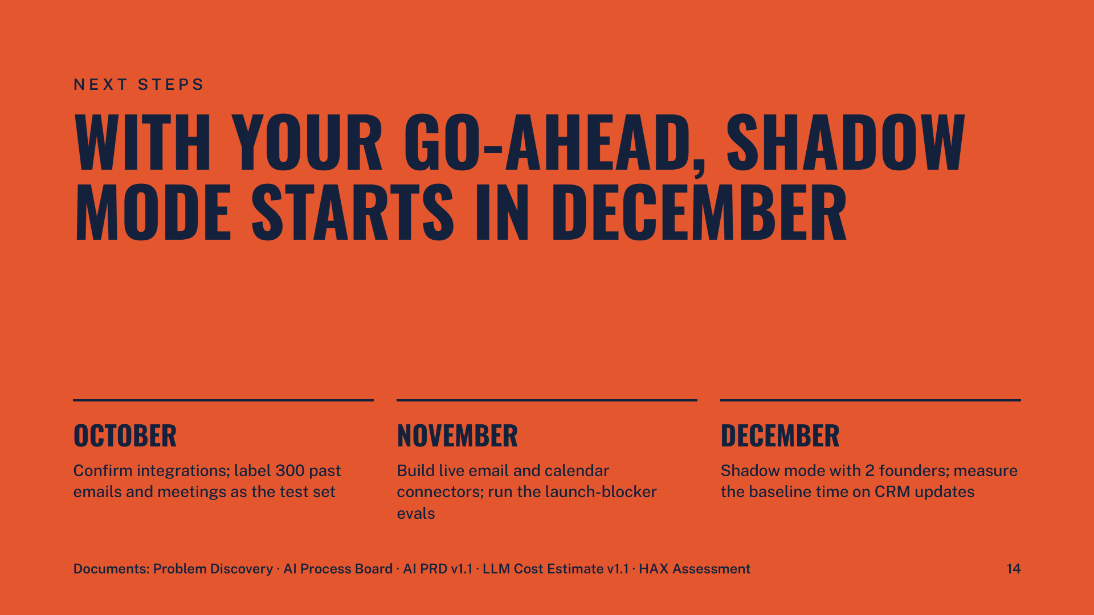
Notes:
Close by asking for the four decisions on the previous slide. Everything referenced today is in the document pack.

